Slide 1

Image Processing for Product Classification
Ms. Ankitha Philip
Associate Professor
Department Of Computer Applications
Amal Jyothi College Of Engineering
Kanjirapally, India
ankithaphilip@amaljyothi.ac.in
Muhamed Ashiq
Department Of Computer Applications
Amal Jyothi College Of Engineering
Kanjirapally, India
Mohammed.ashiqpe@gmail.com

Slide 2
CONTENTS
Abstract
Literature Survey
Introduction
Methodology
Results and Discussion
Conclusion
References

Slide 3
1. Abstract
Mainly Helps out users to identify the product category, rating and price of the product from the visual attributes (Images).
It outlines the research's goal, detailing the intention to explore the application of Convolutional Neural Networks (CNNs) for the classification of electronic products based on their visual attributes.
It briefly explains the implementation approach, highlighting the utilization of CNN models to achieve accurate identification of electronic products from uploaded images.

Slide 4
2. Literature Survey
[1] This paper discusses how deep learning algorithms are improving image processing technology as computers and information technology rapidly advance. It explores methods like particle swarm algorithms and image matching to make image processing more efficient and accurate, helping with tasks like recognizing patterns and removing unnecessary details.
[2] This paper addresses the confusion beginners face when trying to understand parallel and distributed image processing. It offers a simple overview of the mechanisms, tools, and applications in this field, aiming to make it easier for newcomers to grasp the concepts.
[3] Here, the focus is on classifying products on e-commerce platforms. The paper introduces gcForest, a new method that combines decision trees and scanning techniques to classify products accurately. It achieves impressive results, outperforming other methods like SVM and CNN, especially in scenarios with many categories and limited data.

Slide 5
[4] This paper looks into how well different techniques can detect objects in manga images. It compares methods like R-CNN and SSD, finding that some are better at detecting certain objects like character faces or text. The study helps understand which techniques work best for manga images, which have unique visual features.
[5] Finally, this paper tackles the challenge of classifying retail products that have subtle differences and lack clear distinguishing features. It proposes a method that combines text and image features to improve classification accuracy, showing promising results in handling blurry product images.

Slide 6
3. Introduction
Integration of AI in e-commerce: Today's digital landscape sees AI seamlessly integrated into e-commerce, transforming product classification and recommendation systems.
CNNs for electronic product classification: This seminar paper focuses on harnessing the power of convolutional neural networks (CNNs) to streamline the sorting of electronic products based on visual attributes, enhancing the online shopping experience.
Personalized recommendations: AI-driven recommendation systems offer tailored product suggestions, aligning with individual preferences and optimizing the shopping journey for consumers, ultimately driving satisfaction and business growth in the digital marketplace.

Slide 7
4. Methodology
Data Collection: Gather a diverse dataset of electronic product images from various sources, ensuring representation across different categories and visual attributes.
Preprocessing: Preprocess the collected images to standardize their format, resolution, and orientation. Additionally, apply techniques such as resizing, cropping, and normalization to enhance the quality and consistency of the dataset.
Model Training: Utilize a pre-trained CNN model, such as VGGNet or ResNet, as the backbone for feature extraction. Fine-tune the model on the electronic product dataset using transfer learning techniques to adapt it to the specific classification task.
Evaluation: Assess the performance of the trained model using appropriate evaluation metrics such as accuracy, precision, recall, and F1-score. Conduct validation tests on a separate dataset to ensure the generalization capability of the model.

Slide 8
Recommendation System Development: Implement an AI-driven recommendation system that analyzes user behavior and preferences to generate personalized product recommendations. Utilize techniques such as collaborative filtering or content-based filtering to enhance recommendation accuracy.
Integration: Integrate the trained classification model and recommendation system into the e-commerce platform, ensuring seamless interaction with users and compatibility with existing features.
Testing and Optimization: Conduct extensive testing to validate the functionality and performance of the integrated system. Iterate on the design and implementation to optimize efficiency, accuracy, and user experience.
Deployment: Deploy the finalized system on the e-commerce platform, monitoring its performance in real-world scenarios. Continuously collect feedback and data to refine the system and adapt to evolving user needs and preferences.

Slide 9
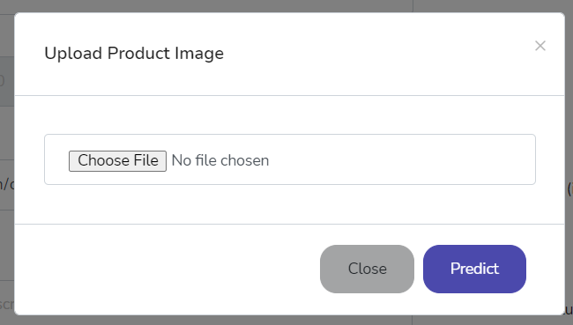
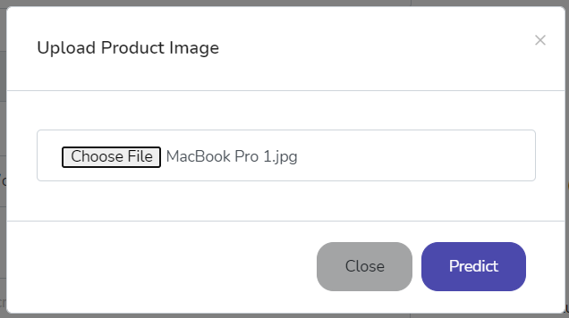
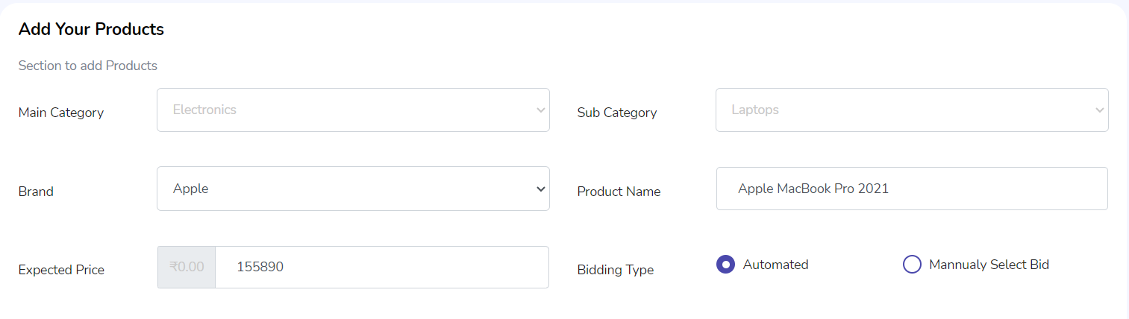
5. Results and Discussion
1. Select the Image to Predict
2. Image Selected
3. After Detection

Slide 10
6. Results and Discussion
Employed data generators with multi-threading for efficient processing of training and validation data.
Orchestrated training using the fit function, adjusting model parameters to minimize loss and extract data patterns.
Balanced the number of epochs to optimize computational time and resource utilization.
Gradually improved model accuracy through iterative training, adjusting parameters based on training data.
Monitored generalization capability with validation data to prevent overfitting and ensure robust performance.
Aimed for optimal performance and effectiveness in real-world applications through strategic parameter tuning and resource management.

Slide 11
7. Conclusion
CNNs have significantly advanced e-commerce and image processing by accurately categorizing electronic products based on visual features.
Utilizing data generators with multi-threading and optimizing model parameters have enhanced training efficiency and effectiveness.
Further refinements in CNN-based classification promise more personalized and efficient shopping experiences.
CNNs unlock new opportunities for innovation in product classification and recommendation systems.

Slide 12
8. References
Y. Zhang and X. Zheng, "Development of Image Processing Based on Deep Learning Algorithm," 2022 IEEE Asia-Pacific Conference on Image Processing, Electronics and Computers (IPEC), Dalian, China, 2022, pp. 1226-1228, doi: 10.1109/IPEC54454.2022.9777479.
H. B. Prajapati and S. K. Vij, "Analytical study of parallel and distributed image processing," 2011 International Conference on Image Information Processing, Shimla, India, 2011, pp. 1-6, doi: 10.1109/ICIIP.2011.6108870.
J. Dai, T. Wang and S. Wang, "A Deep Forest Method for Classifying E-Commerce Products by Using Title Information," 2020 International Conference on Computing, Networking and Communications (ICNC), Big Island, HI, USA, 2020, pp. 1-5, doi: 10.1109/ICNC47757.2020.9049751.
H. Yanagisawa, T. Yamashita and H. Watanabe, "A study on object detection method from manga images using CNN," 2018 International Workshop on Advanced Image Technology (IWAIT), Chiang Mai, Thailand, 2018, pp. 1-4, doi: 10.1109/IWAIT.2018.8369633.
Q. Shen, "Blur Retail Product Images for Fine-grained Image Classification Combining Text Area Features," 2023 IEEE International Conference on Sensors, Electronics and Computer Engineering (ICSECE), Jinzhou, China, 2023, pp. 595-599, doi: 10.1109/ICSECE58870.2023.10263533

Slide 13
Thank You

